Slide 1






Project Management
2-<number>

Slide 2
PROJECTS
Build A
A Done
Build B
B Done
Build C
C Done
Build D
Ship
JAN
FEB
MAR
APR
MAY
JUN
On time!
Unique, one-time operations designed to accomplish a specific set of objectives in a limited time frame.

Slide 3

PROJECT MANAGEMENT
Project has been defined as a temporary endeavor undertaken to create a unique product, service or result. Temporary means that every project has a definite beginning and ending.
Project management is the application of knowledge, skills, tools and techniques to project activities to meet the project requirements. It is a team-based approach for managing projects.
It is a formal or informal and aids a project manager in effectively guiding a project to completion.
Constraints – Scope, Time, Cost & Operations.
Notes:
Temporary – A four days trip to cox’s bazar – if it starts today it will finish on the fourth day. Sonadia Deep Sea Port Project is a 50 year project.
Project Manager is the overall in charge of the project. Modern tools and techniques help him to perform the works in an organized and professional manner.
Constraints example – A four days trip to cox’s bazar.

Slide 4
PROJECT MANAGEMENT (CONTD.)
How is it different?
  Limited time frame
  Narrow focus, specific objectives
  Less bureaucratic
Why is it used?
  Special needs
  Pressures for new or improves products or services

Slide 5
PROJECT MANAGEMENT (CONTD.)
What are the Key Metrics
  Time
  Cost
  Performance objectives
What are the Key Success Factors?
  Top-down commitment
  Having a capable project manager
  Having time to plan
  Careful tracking and control
  Good communications

Slide 6
KEY DECISIONS IN PROJECT MANAGEMENT
Deciding which projects to implement
Selecting the project manager
Selecting the project team
Planning and designing the project
Managing and controlling project resources
Deciding if and when a project should be terminated

Slide 7
PROJECT INITIATION NEEDS
Projects are typically authorized as a result of one or more of the following strategic considerations:
  A market demand
    (e.g., an oil company authorizes a project to build a new refinery in response to chronic gasoline shortages)
  An organizational need
    (e.g., a training company authorizes a project to create a new course in order to increase its revenues)
  A customer request
    (e.g., an electric utility authorizes a project to build a new substation to serve a new industrial park)
  A technological advance
    (e.g., a software firm authorizes a new project to develop a new generation of video games after the introduction of new game- playing equipment by electronics firms)
  A legal requirement
    (e.g., a paint manufacturer authorizes a project to establish guidelines for the handling of a new toxic material).

Slide 8


PROJECT MANAGER
Responsibilities …
Work Quality
Human Resources Time
Communications Costs

Slide 9
PROJECT MANAGEMENT TOOLS
Project Management Tools are -
  Work breakdown structure
  Network diagram
  Gantt

Slide 10
WORK BREAKDOWN STRUCTURE
IT IS A HIERARCHICAL LISTING OF WHAT MUST BE DONE DURING A PROJECT. THIS METHODOLOGY ESTABLISHES A LOGICAL FRAMEWORK FOR IDENTIFYING THE REQUIRED ACTIVITIES FOR THE PROJECT.
IT HAS 4 LEVELS.
LEVEL 1: THE PROJECT.
LEVEL 2 IDENTIFY MAJOR ELEMENTS OF THE PROJECT.
LEVEL 3: IDENTIFY MAJOR SUPPORTING ACTIVITIES FOR EACH OF THE MAJOR ELEMENTS.
LEVEL 4: MAJOR SUPPORTING ACTIVITIES IS BROKEN DOWN INTO A LIST OF ACTIVITIES THAT WILL BE NEEDED TO ACCOMPLISH IT. (WORK PACKAGES)

Slide 11
























WORK BREAKDOWN STRUCTURE
Project X
Level 1
Level 2
Level 3
Level 4

Slide 12

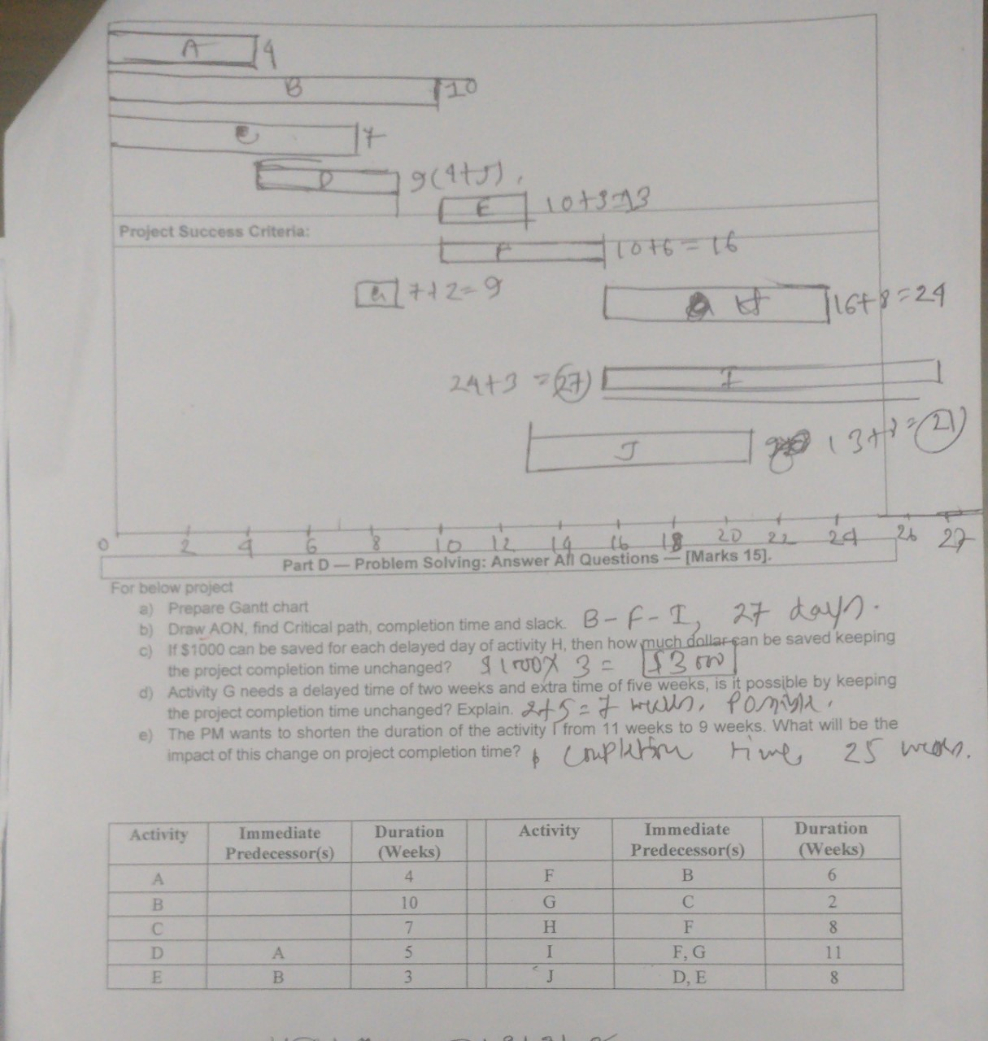

Slide 13
NETWORK DIAGRAM
  Network diagram can be drawn using any of the following
  two techniques.
  1. CPM(Critical Path Method):
A network diagramming technique used to predict total project duration. A critical path is the series of activities that determine the earliest time by which the project can be completed. It is the longest path through the network diagram and has the least amount of slack or float.
slack or float is the amount of time an activity may be delayed without delaying a succeeding activity or the project finish date.
The longest path or the path containing the critical tasks is what is driving the completion date for the project
2. PERT( Program Evaluation and review Technique)

Slide 14
NETWORK DIAGRAM
  By using CPM or PERT managers able to obtain,
  1. A graphical display of project activities.
  2. An estimate of how long the project will take.
  3. An indication of which activities are the most critical to timely project completion.
  4. An indication of how long any activity can be delayed without delaying the project.

Slide 15
NETWORK DIAGRAM
  In CPM method, the activities are presented on NODE (AON) and it follows Deterministic approach (Time duration of each activities are given directly). It is used for construction projects.
  In PERT method, the activities are presented on ARROW (AOA) and it follows Probabilistic approach (Instead of Direct time duration; Optimistic, Most likely and Pessimistic times are given). It is used for R&D oriented projects.

Slide 16
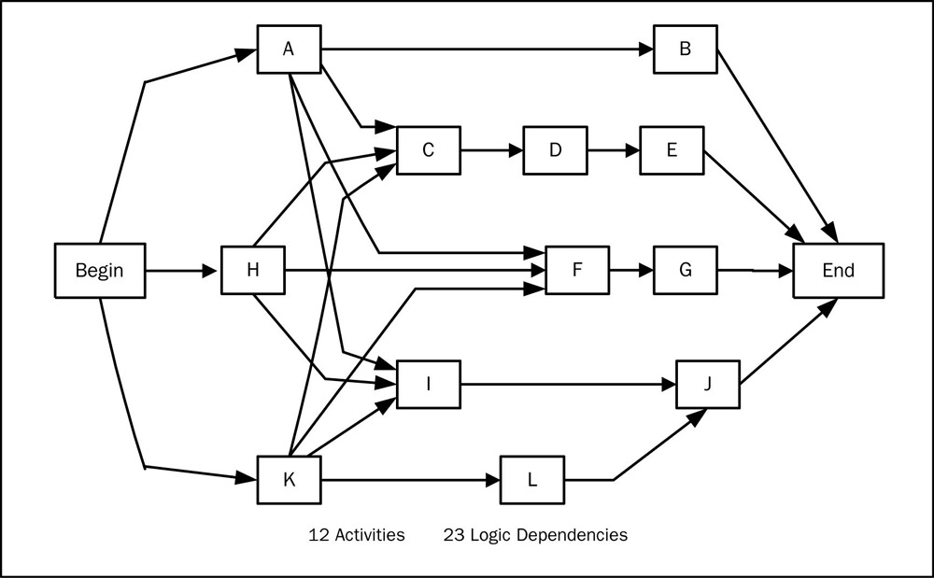
PROJECT NETWORK – ACTIVITY ON NODE

Slide 17
PRECEDENCE DIAGRAM METHOD - PDM
ES
EF
Activity Name
Duration
LS
LF
Notes :
ES : Early Start
EF : Early Finish
Notes :
LS : Late Start
LF : Late Finish

Slide 18
PRECEDENCE DIAGRAM METHOD - PDM (CONTD.)
Backward calculation
5
7
8
8
4
A20
3 days
A30
1 day
7
1
2
9
13
A10
2 days
3
5
6
6
A60
5 days
3
6
7
8
1
2
A40
4 days
A50
2 days
9
13
2
9
3
6
7
8
Forward calculation

Slide 19
CRITICAL PATH & FLOAT CALCULATION
Early
Late
FLOAT
TOTAL
(TF)
Activity No.
Duration (day)
Start Finish
(ES) (EF)
Start Finish
(LS) (LF)
A10 2 1 2 1 2 0
A20 3 3 5 5 7 2
A30 1 6 6 8 8 2
A40 4 3 6 3 6 0
A50 2 7 8 7 8 0
A60 5 9 13 9 13 0
TOTAL FLOAT (TF) = (LS) - (ES) = (LF) - (EF)
TOTAL FLOAT = 0 Critical Path

Slide 20
ADVANTAGES OF PM SOFTWARE
Imposes a methodology
Provides logical planning structure
Enhances team communication
Flag constraint violations
Automatic report formats
Multiple levels of reports
Enables what-if scenarios
Generates various chart types

Slide 21
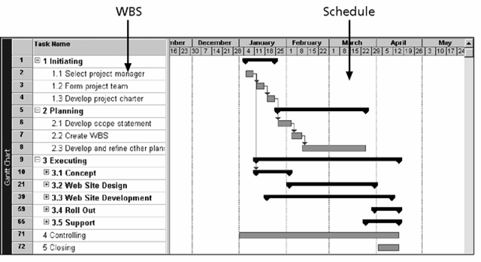
SAMPLE PROJECT SCHEDULE

